Slide 1

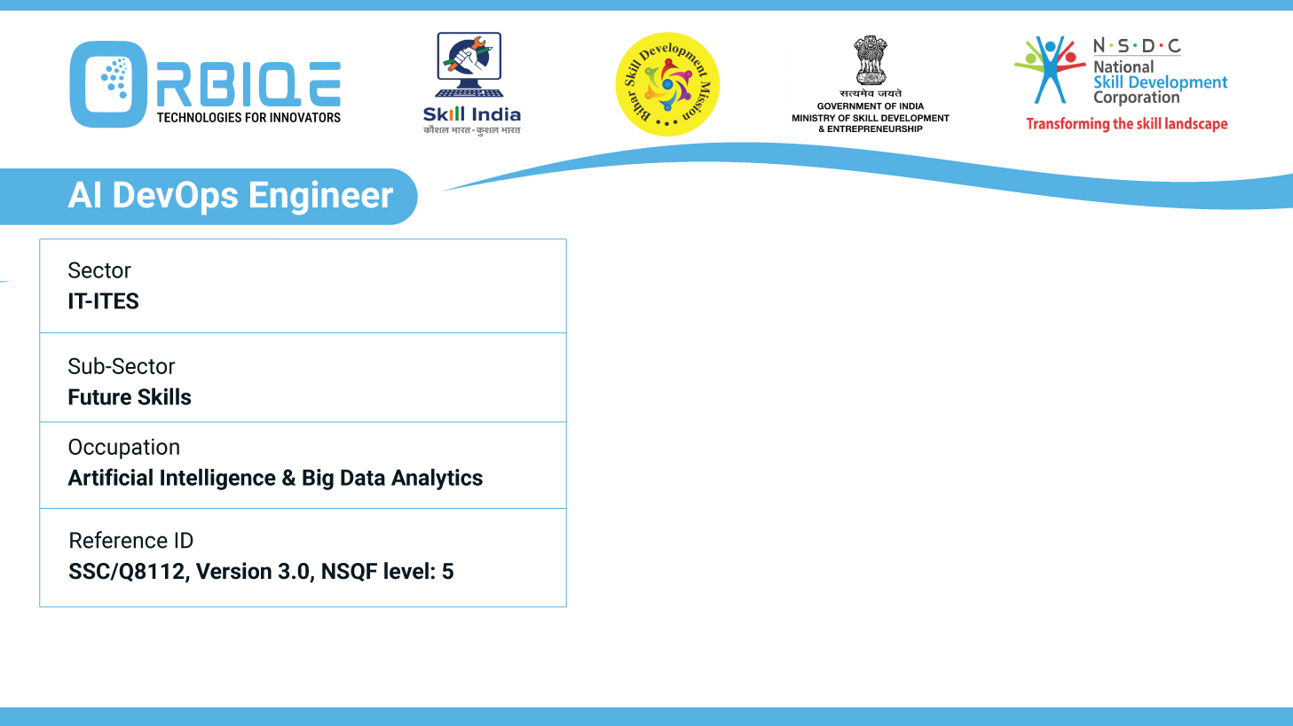
Name- Krishna Kant Dubey

Slide 2

Demystifying AI: General and Narrow Intelligence

Slide 3
Agenda
Define and differentiate between "general" and "narrow" AI
Capabilities and limitations
Potential implications of these AI types in various contexts

Slide 4
Define and differentiate between "general" and "narrow" AI

Slide 5
Capabilities and limitations

Slide 6
Potential implications of these AI types in various contexts

Slide 7
Thank You

